Slide 1

BUTYL TUBES & TYRES
ISO QUALITY

Slide 2
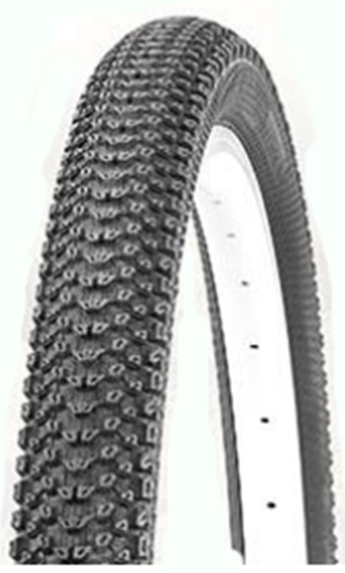

27.5x2.25
29x2.25
W2030
ITW026 ITWO28 | W2030
COMPASS has been certified with the ISO 9001,ISO/TS16949 Quality Management System and ISO14001 Environmental Management System; Our products have passed CCC, ECE, INMETRO,DOT, SASO, GCC, ,BIS and Soncap Certificates.

Slide 3
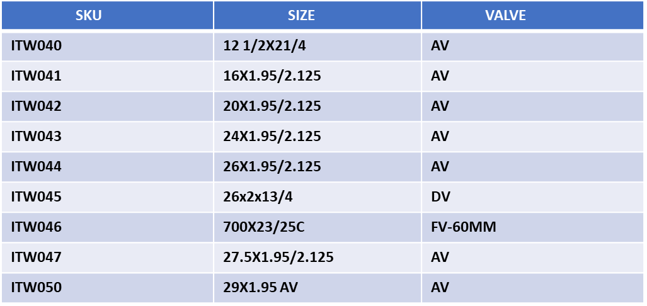


COMPASS has been certified with the ISO 9001,ISO/TS16949 Quality Management System and ISO14001 Environmental Management System; Our products have passed CCC, ECE, INMETRO,DOT, SASO, GCC, ,BIS and Soncap Certificates.
Appointed South African Distributer
116 Frederick street Marshalltown
Johannesburg, Gauteng, South Africa
Phone: +2711 3341106
E Mail : slotar@global.co.za
www.bslotar.co.za

